Slide 1
Real, Live, and Concise: Answering Open-Domain Questions with Word Embedding and Summarization
Rana Malhas, Marwan Torki, Rahma Ali, Tamer Elsayed, Evi Yulianti
TREC-2016, LiveQA Track
November 17th, 2016

Slide 2
Why?
Interested in QA over social media
Interested in live and real-time systems
Because we did very poorly last year!

Slide 3
3 Key Ideas of Our Approach
Retrieve enough/large set of candidate answers
Leverage multiple sources
Learn how to rank retrieved answers
Try new features
Summarize top-ranked answers
Extractive at the sentence level

Slide 4
Answer Retrieval
Q
Answer Retrieval
incoming question
YA! Search
Bing Search
Google
Search
aggregated answers
candidate answers
candidate answers
A
A
A
A
Archived index of 16.9M Qs (2013-2016)
Live API search
Live scrapping of search results
Snippets of top 5
Question-Question similarity
Best answers of top 5
Snippets of top 5

Slide 5
Learning How to Rank Answers
pre-trained GloVE model
TREC’15 QRELS (training data)
Feature Extraction
MK features
Cov features
Metzler-Kanungo:
answer length
exact match
term overlap
LM score
Covariance of word embedding dimensions of GloVE vectors

Slide 6
$v_{n}=Vect(C_{n}$)
$$Document Word List$$
$Observation Matrix$ ($O_{n}$)
$$doc_term 1$$
$$doc_term 2$$
$$doc_term 3$$
$doc_term$ $k_n$
$$doc_term 1$$
$$doc_term 2$$
$$doc_term 3$$
$$doc_term k_n$$
$Covariance Matrix$ $C_{n}$
Document($d_{n}$)
Question-QA Pair
Document Pre-Processing
Lookup Word Embedding Model
Compute Covariance Matrix $C_{n}$
Vectorize $C_{n}$
Learned Word Embedding Model
“voc_term 1”
“voc_term 2”
“voc_term 3”
“voc_term V”
Un-labeled Document Collection
Learn Word Embedding

Slide 7
Learning How to Rank Answers
pre-trained GloVE model
TREC’15 QRELS (training data)
Feature Extraction
features
Learning to Rank
answer ranking model
MK features
Cov features
MART (Multiple Additive Regression Trees)
Metzler-Kanungo:
answer length
exact match
term overlap
LM score
Covariance of word embedding dimensions of GloVE vectors
prediction model in the form of an ensemble of weak prediction models

Slide 8
Live System
Q
Answer Retrieval
incoming question
YA! Search
Bing Search
Google
Search
aggregated answers
candidate answers
candidate answers
A
A
A
Extractive summary of top 3 ranked answers.
Works at sentence level
Model solves maximum coverage problem where coverage of important terms is maximized while redundancy is minimized.
Transformed into a linear programming problem.
A
pre-trained GloVE model
answer ranking model
Answer Ranking
Feature Extraction
features
Ranking
Summarization
A
A
ranked answers
returned answer

Slide 9
Experimental Setup
Training data: TREC 2015 QRELs
Used RankLib for L2R
5-fold cross validation
used MAP as the objective function

Slide 10
Pre-TREC L2R Experiments
Feature Set | Features | MAP with 5-Fold CV
MK | 4 features | 0.4705
MK + Cov | MK + Cov-50D | 0.3180
 | MK + Cov-100D | 0.3260
Model trained over MK features only outperformed other models!
High dimensionality in covariance word embedding features didn’t contribute much given increasing space and time complexities

Slide 11
Submitted Runs
QU2
QU3
Summarizer
QU
MK + Cov
Summarizer
YA!+Bing+Google
Summarizer
YA!+Bing+Google
YA!+Bing+Google
MK + Cov
MART L2R
MK + Cov
MART L2R
MART L2R
Sources Only
Every Thing
Simple

Slide 12
Official Results
Evaluation Measure | Sources Only
AvgScore (0-3) | 0.7842
succ@2+ | 0.4236
succ@3+ | 0.2532
succ@4+ | 0.1074
prec@2+ | 0.4419
prec@3+ | 0.2641
prec@4+ | 0.1120
Questions Answered | 973

Slide 13
Official Results
Evaluation Measure | Sources Only | Every Thing
AvgScore (0-3) | 0.7842 | 0.8768
succ@2+ | 0.4236 | 0.4670
succ@3+ | 0.2532 | 0.2956
succ@4+ | 0.1074 | 0.1143
prec@2+ | 0.4419 | 0.5011
prec@3+ | 0.2641 | 0.3171
prec@4+ | 0.1120 | 0.1226
Questions Answered | 973 | 946

Slide 14
Official Results
Evaluation Measure | Sources Only | Every Thing | Simple
AvgScore (0-3) | 0.7842 | 0.8768 | 0.9005
succ@2+ | 0.4236 | 0.4670 | 0.4631
succ@3+ | 0.2532 | 0.2956 | 0.2975
succ@4+ | 0.1074 | 0.1143 | 0.1399
prec@2+ | 0.4419 | 0.5011 | 0.4667
prec@3+ | 0.2641 | 0.3171 | 0.2999
prec@4+ | 0.1120 | 0.1226 | 0.1410
Questions Answered | 973 | 946 | 1007

Slide 15
Official Results
Evaluation Measure | Sources Only | Every Thing | Simple | Track Average
AvgScore (0-3) | 0.7842 | 0.8768 | 0.9005 | 0.5766
succ@2+ | 0.4236 | 0.4670 | 0.4631 | 0.3042
succ@3+ | 0.2532 | 0.2956 | 0.2975 | 0.1898
succ@4+ | 0.1074 | 0.1143 | 0.1399 | 0.0856
prec@2+ | 0.4419 | 0.5011 | 0.4667 | 0.3919
prec@3+ | 0.2641 | 0.3171 | 0.2999 | 0.2429
prec@4+ | 0.1120 | 0.1226 | 0.1410 | 0.108
Questions Answered | 973 | 946 | 1007 | 771.0385

Slide 16
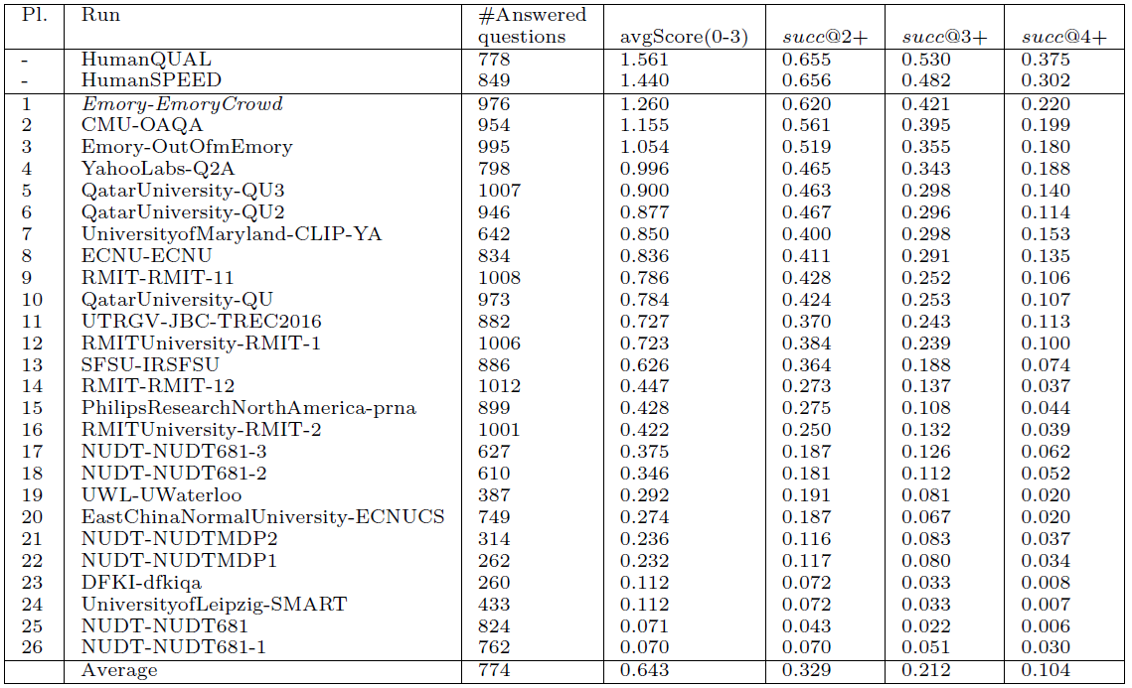

Slide 17
Sources of Returned Answers in “Sources Only”!
 | Answers | Average score | % Score Contribution
Bing | 609 | 0.7904 | 63%
Google | 92 | 0.6712 | 10%
YA! | 273 | 0.7377 | 27%

Slide 18
Conclusion
3-stage QA system: answer retrieval, answer ranking and summarization
MK features are very effective!
Cov over Word Embeddings didn’t prove itself (yet!)
Relying on Web Search is risky!
Ranked 4th among automatic runs!

Slide 19
Future Work
Ablation study!
Better ways to combine word embedding features with others
Scalable answer retrieval (to avoid timeout problems)
Apply L2R ot sentence level
Learn when (not) to summarize

Slide 20
Acknowledgment

Slide 21
Thank You!

Slide 22
Question: Foot pain unable to walk?
Answer: X-rays and other imaging tests (CT scans, MRIs) may be ordered if there are not obvious signs of an underlying cause, or if you are unable to put weight on your foot. Physical examinations may also reveal where the problem is located in the foot. Treatment Options for Your Foot Pain There are numerous things you can do to control or treat your foot pain. The first step is seeing a foot specialist, a podiatrist, or a foot and ankle surgeon. You can sometimes help yourself by using the acronym RICE to relieve foot pain. RICE stands for Rest, Ice, Compression, and Elevation.
Sources Only
Bing
Question: Do you need an exotic animal permit to own a peacock?
Answer: You need a licence to keep some animals, eg: wild cats primates wild dogs, eg wolves certain pigs, eg wild boar marsupials See the full list of animals you need a licence for. Hybrid or cross-bred animals may need a licence, depending on how far removed the animal is from its wild ancestor. If you’re not sure, ask your local council.
Every Thing
Summary
Question: Which is an example of the absolutism under peter the great?
Answer: fighting the great northern war required unprecedented economic resources, and russia's yawning budget deficit and aging infrastructure meant that the state could not effectively allocate resources and money in wartime. peter's government was constantly in dire need of money, and at first it responded by monopolizing certain strategic industries, such as salt, alcohol, oak, and tar. peter also taxed many russian cultural customs (such as bathing, fishing, beekeeping, and wearing beards) and issued tax stamps for paper goods. however, with each new tax came new loopholes and new ways to avoid them, and so it became clear that tax reform was simply not enough. **the solution was a sweeping new poll tax, which replaced a household tax on cultivated land. previously, peasants had skirted the tax by combining several households into one estate; now, however, each peasant was assessed individually for a tax of 70 kopeks, paid in cash.
Simple
YA!

